Slide 1
General
Lesson 01

Slide 2
Lesson Objectives
Mobile Web Overview
Web Apps vs Native Apps
HTML and CSS for Mobile
Responsive Design
Notes:
Explain the lesson coverage

Slide 3
1.1 Mobile Web Overview
In current age there are 6.8 billion people on the planet where almost 5.1 billion people are using cell phone .
The number of users accessing the Internet on their smartphones has more than doubled in the past 5 years .
With the continued rapid expansion of the number, variety and sophistication of mobile devices on the market and in use today, the need for effective, user-friendly, high performance mobile applications is likely to increase substantially.

Slide 4
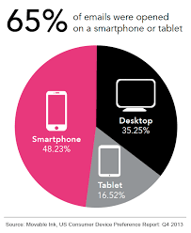
1.1:1: Mobile web overview Introduction
Mobile Web Overview
Notes:
Add the notes here.
Additional notes for instructor

Slide 5
1:1.2: Mobile web overview
Mobile Web Overview
One can say the easiest method to use to create a mobile-optimized website is to build a responsive site – using a responsive website theme or template.
Responsive website themes and templates adjust the layout of the screen to where the page, URL, and images all remain the same .
Notes:
Additional notes for instructor

Slide 6
1.1.3: Why Mobile Web?
Why Mobile Web?
Why we need to optimize website for mobile devices.
Few reasons are mentioned below
  Enhanced user browsing experience for your visitors.
  Compatibility with multiple types of devices
  The mobile user market is continuously growing at a very fast pace
  Mobile optimized websites are SEO friendly and can boost search engine rankings
  Increased visibility to the mobile market.
Notes:
Add the notes here.
Additional notes for instructor

Slide 7
1.2. web apps Vs native apps
Web Apps vs Native Apps
Few points a developer need to think before design any app :
Speed and performance of app
Any device specific features in app
Internet enabled app
Is the app to support multiple mobile platforms and devices .
Budget, vs. the estimated cost of developing app
Notes:
In order to decide if you want to develop a native app of Web app, you need to consider the following points:
How important speed and performance would be, to you
If you would like your app to include any device-specific features
If you want your app to be Internet-enabled
If you want your app to support multiple mobile platforms and devices and if yes, how many
Your budget, vs. the estimated cost of developing your app
If you would like to monetize your app in the future ere.
Additional notes for instructor

Slide 8
1.2. web apps Vs native apps
Web Apps vs Native Apps
In order to decide which app to develop , its all depend upon requirements :
A Native App is basically mobile device specific ,it is developed essentially for one particular mobile device and is installed directly onto the device itself. Users of native apps usually download the app via app stores online or the app marketplace, such as the Apple App Store, the Google Play store and so on.
Example : Camera+ app for Apple’s iOS devices.
A Web App are Internet-enabled apps which are accessible via the mobile device’s Web browser. Those apps need not be downloaded onto the user’s mobile device in order to be accessed.
Exp: The Safari browser is a good example of a mobile Web app.
Notes:
Add the notes here.
Additional notes for instructor

Slide 9
1.2.1 Web apps
Pros and Cons of Web Apps
As Web apps have a common code base across multiple mobile platforms ,these are much easier to maintain .
Web apps can be manipulated to be made compatible with any older mobile device.
Web apps do not require developers to submit their app to any app store for approval. As per the developer’s preferences, it can be released at any time and in any form.
Notes:
Web apps are much easier to maintain, as they have a common code base across multiple mobile platforms.
Web apps can be manipulated so as to be made compatible with any older mobile device.
Web apps do not require developers to submit their app to any app store for approval. Of course, the Apple App Store does feature a list of Web apps.
Since Web apps do not need to be approved by the app marketplace, they can be released at any time and in any form, as per the developer’s preferences.
Users need not bother with visiting an app store to download Web apps or updating the same on their mobile devices.
FAQ on Designing Multi-Platform Mobile Applications
Mobile Web apps only have limited scope as far as accessing a mobile device’s features is concerned.
Web apps that support multiple mobile browsers can prove to be an expensive proposition for developers, as it raises the costs of developing and maintaining them.
Different users work with different mobile browsers. This can make it difficult for you to maintain a record of their usage patterns and also provide support for all of them.
Users may sometimes find it difficult to discover a Web app, as it is not systematically listed in any app store.
Since there is no regularized quality control system for Web apps, users may not always be guaranteed safety and security of the app.
Common Mistakes to Avoid during Mobile App Development
Additional notes for instructor

Slide 10
1.2.2 Web apps
Pros and Cons of Web Apps
Users may sometimes find it difficult to discover a Web app, as it is not systematically listed in any app store.
Since there is no regularized quality control system for Web apps, users may not always be guaranteed safety and security of the app.
only have limited scope as far as accessing a mobile device’s features is concerned.
Web apps which supports multiple mobile browsers can prove to be an expensive proposition for developers, as it raises the costs of developing and maintaining them.
Notes:
Web apps are much easier to maintain, as they have a common code base across multiple mobile platforms.
Web apps can be manipulated so as to be made compatible with any older mobile device.
Web apps do not require developers to submit their app to any app store for approval. Of course, the Apple App Store does feature a list of Web apps.
Since Web apps do not need to be approved by the app marketplace, they can be released at any time and in any form, as per the developer’s preferences.
Users need not bother with visiting an app store to download Web apps or updating the same on their mobile devices.
FAQ on Designing Multi-Platform Mobile Applications
Mobile Web apps only have limited scope as far as accessing a mobile device’s features is concerned.
Web apps that support multiple mobile browsers can prove to be an expensive proposition for developers, as it raises the costs of developing and maintaining them.
Different users work with different mobile browsers. This can make it difficult for you to maintain a record of their usage patterns and also provide support for all of them.
Users may sometimes find it difficult to discover a Web app, as it is not systematically listed in any app store.
Since there is no regularized quality control system for Web apps, users may not always be guaranteed safety and security of the app.
Common Mistakes to Avoid during Mobile App Development
Additional notes for instructor

Slide 11
1.2.3 Native apps
Pros and Cons of Native Apps
Native apps work with the device’s built in features , therefore it is easier to work with and also faster in performance on that device .
These apps get full support from app stores and marketplaces.
Users can easily find the apps and download of their choice from these stores
These apps are completely secure for the user .
Notes:
Native apps work with the device’s built in features , therefore it is easier to work with and also faster in performance on that device .
These apps get full support from app stores and marketplaces. Users can easily find and download apps of their choice from these stores.
Because these apps have to get the approval of the app store they are intended for, the user can be assured of complete safety and security of the app.
Native apps work out better for developers, who are provided the SDK and all other tools to create the app with much more ease.
Additional notes for instructor

Slide 12
1.2.3 Native apps
Pros and Cons of Native Apps
Native apps will be more expensive proposition to the developer , if they are trying to develop the app to be compatible with multiple mobile devices and platforms.
Maintenance cost also very high for native apps when they are targeting to multiple platforms.
The process of getting the app which is approved at the app store can prove to be long and tedious for the developer and need not always result in success .
Users of different mobile devices may be using different versions of the app, which makes it difficult for the developer to maintain and offer support.
Notes:
Native apps will be more expensive proposition to the developer , if they are trying to develop the app to be compatible with multiple mobile devices and platforms.
The app maintenance cost and app updating is also higher for native apps, especially if this app supports more than one mobile platform .
The process of getting the app which is approved at the app store can prove to be long and tedious for the developer and need not always result in success .
Users of different mobile devices may be using different versions of the app, which makes it difficult for the developer to maintain and offer support.
Additional notes for instructor

Slide 13

1.3. Html and CSS for Mobile
HTML and CSS for Mobile
In today market demand of mobile devices are huge .
Notes:
Developing applications for smartphones is quite different from developing websites for the web, desktops and laptops. Today, there are more number of mobile devices than people present in the world. These mobile devices have varying screen sizes and processing powers. Mobile devices also vary on how they access the Internet; they can be connected via Wi-Fi network or can run on a slow 2G network. All these factors make mobile applications development challenging and different from traditional web applications development. - See more at: http://www.rishabhsoft.com/blog/building-mobile-apps-with-html5#sthash.L4JaRE0p.dpuf
With mobility coming into the picture, HTML5 played an important role in creating responsive and intuitive web pages. Moreover, it also enabled the rise of web applications along with cross platform application support. We at Mobile Programming LLC, have varied experience and well-honed skills for delivering immersive HTML5 applications on a range of platforms. Our core proficiency is to design and develop web based applications that offer native experience along with easy customizability.
In a mobile we can create different task by using Html5
View contacts where we can create calling sms features by using Html5
We can create navigational map by using google map api , geolocation
Camera features and media libraries
Html5 app :
It provides certain functionality to the user . Made with web technologies i.e. Html5 , css3 , Js
It is different to a web site.
Different consideration towards mobile design :
Limited internet connectivity .
Less resources than PC
Range of device screen sizes
Think about the end user
Additional notes for instructor

Slide 14
1.3. Html and CSS for Mobile
HTML and CSS for Mobile
To Develop an applications for smartphones is quite different from developing websites for the web, desktops and laptops .
As we know , few points we need to think before design any apps for mobile devices :
  Limited internet connectivity :
  They can be connected via Wi-Fi network or can run on a slow 2G network
  Less resources than PC : Devices have different processing powers
  Range of device screen sizes
  Think about the end user
Notes:
Developing applications for smartphones is quite different from developing websites for the web, desktops and laptops. Today, there are more number of mobile devices than people present in the world. These mobile devices have varying screen sizes and processing powers. Mobile devices also vary on how they access the Internet; they can be connected via Wi-Fi network or can run on a slow 2G network. All these factors make mobile applications development challenging and different from traditional web applications development. - See more at: http://www.rishabhsoft.com/blog/building-mobile-apps-with-html5#sthash.L4JaRE0p.dpuf
With mobility coming into the picture, HTML5 played an important role in creating responsive and intuitive web pages. Moreover, it also enabled the rise of web applications along with cross platform application support. We at Mobile Programming LLC, have varied experience and well-honed skills for delivering immersive HTML5 applications on a range of platforms. Our core proficiency is to design and develop web based applications that offer native experience along with easy customizability.
In a mobile we can create different task by using Html5
View contacts where we can create calling sms features by using Html5
We can create navigational map by using google map api , geolocation
Camera features and media libraries
Html5 app :
It provides certain functionality to the user . Made with web technologies i.e. Html5 , css3 , Js
It is different to a web site.
Different consideration towards mobile design :
Limited internet connectivity .
Less resources than PC
Range of device screen sizes
Think about the end user
Additional notes for instructor

Slide 15
1.3. Html and CSS for Mobile
HTML and CSS for Mobile
With mobility coming into the picture, HTML5 played an important role in creating responsive and intuitive web pages.
It also enabled the rise of web applications along with cross platform application support.
In a mobile we can create different task by using Html5 and CSS3
  View contacts where we can create calling sms features by using Html5
  We can create navigational map by using google map api , geolocation
  Camera features and media libraries
Notes:
With mobility coming into the picture, HTML5 played an important role in creating responsive and intuitive web pages. Moreover, it also enabled the rise of web applications along with cross platform application support. We at Mobile Programming LLC, have varied experience and well-honed skills for delivering immersive HTML5 applications on a range of platforms. Our core proficiency is to design and develop web based applications that offer native experience along with easy customizability.
In a mobile we can create different task by using Html5
View contacts where we can create calling sms features by using Html5
We can create navigational map by using google map api , geolocation
Camera features and media libraries
Html5 app :
It provides certain functionality to the user . Made with web technologies i.e. Html5 , css3 , Js
It is different to a web site.
Different consideration towards mobile design :
Limited internet connectivity .
Less resources than PC
Range of device screen sizes
Think about the end user
Additional notes for instructor

Slide 16
1.3. Html and CSS for Mobile
HTML and CSS for Mobile
To develop mobile web apps with good UX , one need to follow a set of design guidelines :
  Use CSS3 rather then jQuery to add Animations :
  CSS3 animations are handled in the browser natively and it can make better use
  of the hardware configurations. which helps in increasing performance of
  mobile web app.
  Use CSS3 Gradients Instead of Images:
  The CSS3 gradients deliver unique UX and provide flexibility to mobile app
  without cropping any images used for the page design. It helps to preserve
  bandwidth and improve web app performance .
Notes:
While developing mobile web apps with good UX, you need to follow a set of design guidelines:
Use CSS3 rather than jQuery to Add Animations : Whenever possible use CSS3 animations as they are handled in the browser natively and can make better use of the hardware configurations. This helps in increasing performance of your mobile web app.
Use CSS3 Media Queries To Achieve Responsive Design: Mobile devices these days have varying screen sizes and it’s a basic expectation that a mobile web app will fit on the screen of the device. By using CSS3 media queries, you can achieve responsive designs for the same code base and provide an optimal viewing experience to a wide range of devices.
Use CSS3 Gradients Instead of Images: You can preserve bandwidth and improve your web app performance by using CSS3 gradients. The gradients deliver unique UX and provide flexibility to your app without cropping any images used for the page design.
Use SPA (Single Page Application): SPA (for example, Gmail) provides a quick and responsive navigational experience to the user. They are distinguished by their ability to redraw any part of the UI without demanding a server roundtrip to retrieve a page. When building HTML5 mobile applications, opt for SPA as it does not complicate your development process. Kendo UI Mobile is an excellent framework for building single page applications.
Use Local Data Storage and Enable Offline Mode: All modern mobile browsers today support HTML5 W3C standards, as they are updated quite frequently compared to their desktop counterparts. Although we can safely assume that these features will be available on the smartphone browsers, it’s a good idea to check whether the features are enabled on the client browser using simple JavaScript conditional statements.
Are you currently facing mobile optimization challenges? And want to solve them swiftly in a limited budget and timeframe?
We help organizations to achieve faster go-to-market, delivering quality HTML5 web apps developed as per your requirement and budget.
Additional notes for instructor

Slide 17
1.3. Html and CSS for Mobile
HTML and CSS for Mobile
  Use CSS3 Media Queries To Achieve Responsive Design ::
  As we know , Mobile devices these days have varying screen sizes and
  it’s a basic expectation that a mobile web app will fit on the screen of the device .
  By using CSS3 media queries, one can achieve responsive designs for the same
  code base and provide an optimal viewing experience to a wide range of devices.
  Use SPA (Single Page Application) :
  SPA provides a quick and responsive navigational experience to the user. SPA has
  the ability to redraw any part of the UI without demanding a server roundtrip to
  retrieve a page. Example Gmail site . When building HTML5 mobile applications,
  select for SPA does not complicate your development process.
Notes:
While developing mobile web apps with good UX, you need to follow a set of design guidelines:
Use CSS3 rather than jQuery to Add Animations : Whenever possible use CSS3 animations as they are handled in the browser natively and can make better use of the hardware configurations. This helps in increasing performance of your mobile web app.
Use CSS3 Media Queries To Achieve Responsive Design: Mobile devices these days have varying screen sizes and it’s a basic expectation that a mobile web app will fit on the screen of the device. By using CSS3 media queries, you can achieve responsive designs for the same code base and provide an optimal viewing experience to a wide range of devices.
Use CSS3 Gradients Instead of Images: You can preserve bandwidth and improve your web app performance by using CSS3 gradients. The gradients deliver unique UX and provide flexibility to your app without cropping any images used for the page design.
Use SPA (Single Page Application): SPA (for example, Gmail) provides a quick and responsive navigational experience to the user. They are distinguished by their ability to redraw any part of the UI without demanding a server roundtrip to retrieve a page. When building HTML5 mobile applications, opt for SPA as it does not complicate your development process. Kendo UI Mobile is an excellent framework for building single page applications.
Use Local Data Storage and Enable Offline Mode: All modern mobile browsers today support HTML5 W3C standards, as they are updated quite frequently compared to their desktop counterparts. Although we can safely assume that these features will be available on the smartphone browsers, it’s a good idea to check whether the features are enabled on the client browser using simple JavaScript conditional statements.
Are you currently facing mobile optimization challenges? And want to solve them swiftly in a limited budget and timeframe?
We help organizations to achieve faster go-to-market, delivering quality HTML5 web apps developed as per your requirement and budget.
Additional notes for instructor

Slide 18
1.3. Html and CSS for Mobile
HTML and CSS for Mobile
  Use Local Data Storage and Enable Offline Mode:
  As we know , all modern mobile browsers today support HTML5 W3C standards,
  as they are updated quite frequently compared to their desktop . Although we can
  safely assume that these features will be available on the smartphone browsers,
  it’s a good idea to check whether the features are enabled on the client browser
  using simple JavaScript conditional statements.
Notes:
While developing mobile web apps with good UX, you need to follow a set of design guidelines:
Use CSS3 rather than jQuery to Add Animations : Whenever possible use CSS3 animations as they are handled in the browser natively and can make better use of the hardware configurations. This helps in increasing performance of your mobile web app.
Use CSS3 Media Queries To Achieve Responsive Design: Mobile devices these days have varying screen sizes and it’s a basic expectation that a mobile web app will fit on the screen of the device. By using CSS3 media queries, you can achieve responsive designs for the same code base and provide an optimal viewing experience to a wide range of devices.
Use CSS3 Gradients Instead of Images: You can preserve bandwidth and improve your web app performance by using CSS3 gradients. The gradients deliver unique UX and provide flexibility to your app without cropping any images used for the page design.
Use SPA (Single Page Application): SPA (for example, Gmail) provides a quick and responsive navigational experience to the user. They are distinguished by their ability to redraw any part of the UI without demanding a server roundtrip to retrieve a page. When building HTML5 mobile applications, opt for SPA as it does not complicate your development process. Kendo UI Mobile is an excellent framework for building single page applications.
Use Local Data Storage and Enable Offline Mode: All modern mobile browsers today support HTML5 W3C standards, as they are updated quite frequently compared to their desktop counterparts. Although we can safely assume that these features will be available on the smartphone browsers, it’s a good idea to check whether the features are enabled on the client browser using simple JavaScript conditional statements.
Are you currently facing mobile optimization challenges? And want to solve them swiftly in a limited budget and timeframe?
We help organizations to achieve faster go-to-market, delivering quality HTML5 web apps developed as per your requirement and budget.
Additional notes for instructor

Slide 19
1.4 : Responsive Design
Responsive Design
The rapid spread of mobile devices has turned the world of web design upside down. Users no longer view web content only on traditional desktop systems, but are increasingly using smartphones, tablets, and other devices with a wide range of dimensions. The challenge for web designers is to ensure that their websites look good not only on a big screen, but also on a tiny phone and everything in between.
The important objective is ,a web page should look good, and be easy to use, regardless of the device!
Notes:
Additional notes for instructor

Slide 20
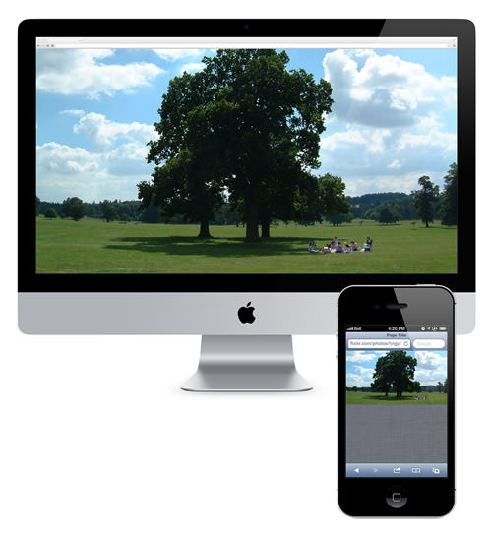
1.4 : Responsive Design
Responsive Design
Web pages should not leave out information to fit smaller devices, but rather adapt its content to fit any device:
Notes:
Additional notes for instructor

Slide 21
1.4 : Responsive Design
Responsive Design
Responsive Web Design always makes web page look good on all devices (desktops, tablets, and phones).
Responsive Web Design is about using CSS and HTML to resize, hide, shrink, enlarge, or move the content to make it look good on any screen:
Responsive web design is not a program or a JavaScript.
Notes:
Additional notes for instructor

Slide 22
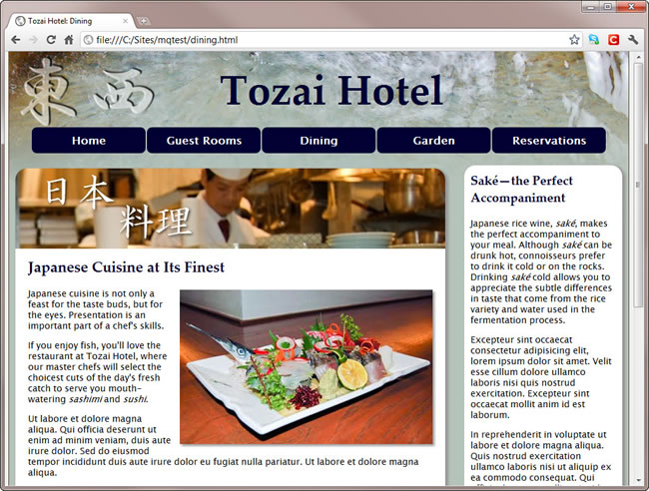
1.4 : Responsive Design
Responsive Design
When viewed on a desktop, the page has a two-column layout.
Notes:
Responsive web design is a recent strategy for building web sites that can respond and adapt to multiple devices and their respective resolutions. Mobile first is the concept of creating the design for your mobile web site first, and then building out that design for larger resolutions. This course covers the concepts that developers need to know to be able to work in this new way of designing web sites.
Additional notes for instructor

Slide 23
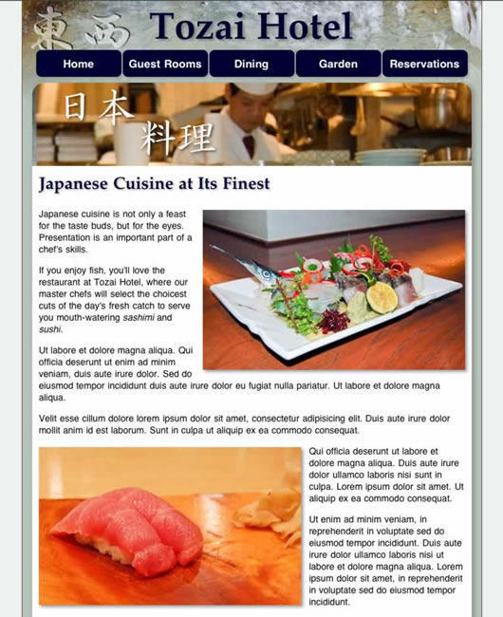
1.4 : Responsive Design
Responsive Design
The layout switches to a single column to fit the narrower screen of a tablet
Notes:
When viewed in an iPod touch, the menu is rearranged and the images are scaled down. The different styles are delivered to each device using media queries.
Additional notes for instructor

Slide 24

1.4 : Responsive Design
Responsive Design
When viewed in an iPod touch, the menu is rearranged and the images are scaled down. The different styles are delivered to each device using media queries.
Notes:
Additional notes for instructor

Slide 25
1.4 : Responsive Design – different CSS features
Responsive Design
Different CSS features are used to design a responsive web design are
  Viewport :
  This is the user's visible area of a web page.
  Grid views :
  web pages are based on a grid-view, it means that the page is
  divided into columns:
  Media queries :
  It uses @media rules to include a block of CSS rules based
  on condition
Notes:
Additional notes for instructor

Slide 26
1.4 : Responsive Design – Viewport
Viewport
The viewport varies with the device, and will be smaller on a mobile phone than on a computer screen.
Previously the web pages are designed to display in desktop .
When this pages are shown in tablet and mobile devices, fixed size web pages were too large to fit the viewport.
To solve this problem , browsers on small devices scaled down the entire web page to fit the screen.
Notes:
Additional notes for instructor

Slide 27
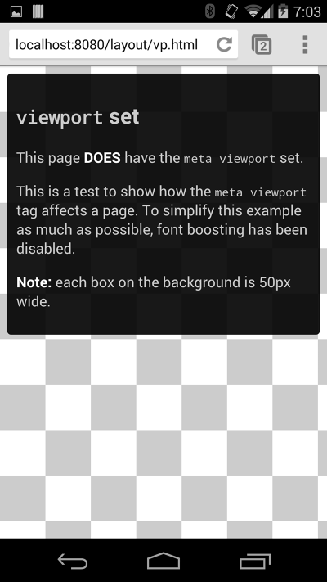
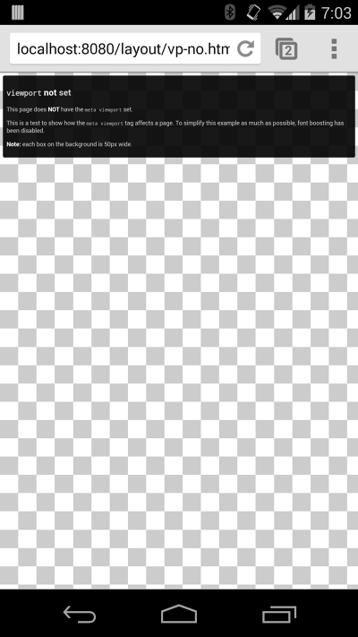
1.4 : Responsive Design – Viewport
Viewport
Web page without Viewport
Web page With Viewport
Notes:
Web page without Viewport and Web page With Viewport
Additional notes for instructor

Slide 28
1.4 : Responsive Design – Viewport
Viewport
Pages optimized for a variety of devices must include a meta viewport tag in the head of the document.
A meta viewport tag gives the browser instructions on how to control the page's dimensions and scaling.
<meta name="viewport" content="width=device-width, initial-scale=1.0">
Notes:
Use the meta viewport tag to control the width and scaling of the browser's viewport.
Include width=device-width to match the screen's width in device-independent pixels.
Include initial-scale=1 to establish a 1:1 relationship between CSS pixels and device-independent pixels.
Ensure your page is accessible by not disabling user scaling.
Additional notes for instructor

Slide 29
1.4 : Responsive Design – Media queries
Media Queries
Media queries are an excellent way to deliver different styles to different devices, providing the best experience for each type of user.
A part of the CSS3 specification, media queries expand the role of the media attribute that controls how your styles are applied.
.
Notes:
Additional notes for instructor

Slide 30
1.4 : Responsive Design – Media queries
Media Queries
It's been common practice for years to use a separate style sheet for printing web pages by specifying media="print" . Media queries take this idea to the next level by allowing designers to target styles based on a number of device properties, such as screen width, orientation, and so on.
Next few slides demonstrate media queries in action. They all show the same web page as viewed in a desktop browser, on a tablet, and on an iPod touch.
Notes:
Additional notes for instructor

Slide 31
1.4 : Responsive Design – Media queries
Media Queries
A simple example of a media query might look like this:
In this example, the media query has been added to the <link> tag.
media=“only screen and (max-width: 400px)” ,
says apply this style sheet only to a device that has a screen and only if the browser window is no wider than 400 pixels. Same can be specified in an external file as shown below
<link href="css/phone.css" rel="stylesheet" type="text/css"
media="only screen and (max-width: 400px)" >
@media screen and (max-width: 400px)
{
.class { background: #ccc; }
}
Notes:
Additional notes for instructor

Slide 32
1.4 : Responsive Design – Media queries
Media Queries
Some of the important properties of Media Query are
  Width
  Height
  Device-width
  Device-height
  Orientation
width and height refer to the size of the browser viewport, whereas device-width and device-height refer to the dimensions of the monitor
Notes:
Additional notes for instructor

Slide 33
1.4 : Responsive Design – Media queries
How to apply Media Queries?
To add a media query to the media attribute, you set one or more conditions using the media features in Table from previous slide
Ex:
Some media features, such as color , monochrome , and grid , can be used as conditions without specifying a value
Ex:
media="screen and (min-width: 401px) and (max-width: 600px)"
media="screen and (color)"
Notes:
Media queries are Boolean: they will either be true or false. If the entire statement is true, the style sheet is applied. If false, it will be ignored. So when using the above query, all parts must be true for the style sheet to be applied. In other words, it will apply only to screens between 401 and 600 pixels wide.
Additional notes for instructor

Slide 34
1.4 : Responsive Design – Media queries
Specifying alternatives with MQ
There is no keyword to specify alternative media features. Instead, you list alternatives as a comma-separated list like this:
Negative Coordinates: To specify a negative condition, you can precede the media declaration with the keyword not like this:
media="screen and (min-width: 769px), print and (min-width: 6in)"
media="not screen and (monochrome)"
Notes:
You can't use not in front of an individual condition. The keyword must come at the beginning of the declaration, and it negates the whole declaration. So, the preceding example applies to all devices except monochrome screens.
Additional notes for instructor

Slide 35
1.4 : Responsive Design – Media queries
Hiding media queries from older browsers
The media queries specification also provides the keyword only , which is intended to hide media queries from older browsers
Ex:
Browsers that don't recognize media queries expect a comma-separated list of media types, and the specification says they should truncate each value immediately before the first non alphanumeric character that isn't a hyphen. So, an old browser should interpret the preceding example as this:
media="only"
media="only screen and (min-width: 401px) and (max-width: 600px)"
Notes:
Like not , the ‘only’ keyword must come at the beginning of the declaration
Because there is no such media type as only , the style sheet is ignored. Similarly, an old browser should interpret the following as media="screen" :
media="screen and (min-width: 401px) and (max-width: 600px)"
In other words, it should apply the style rules to all screen devices, even though it doesn't know what the media queries mean. Unfortunately, IE 6–8 failed to implement the specification correctly. Instead of applying the styles to all screen devices, it ignores the style sheet altogether.
In spite of this behavior, it's still recommended to prefix media queries with only if you want to hide the styles from other, less common browsers.
Additional notes for instructor

Slide 36
1.4 : Responsive Design – Media queries
Using media queries with @import and @media
While attaching external style sheet media queries can be written using @import and @media
Ex:
@import url("phone.css") only screen and (max-width:400px);
@media only screen and (max-width:400px) {
#navbar {
float: none;
width: 400px;
}
}
Notes:
Additional notes for instructor

Slide 37
1.4 : Responsive Design – Media queries
Responsive Design with CSS3 Media Queries
Screen resolution nowadays ranges from 320px (iPhone) to 2560px (large monitor) or even higher. Users no longer just browse the web with desktop computers. Users now use mobile phones, small notebooks, tablet devices such as iPad or Playbook to access the web. So the traditional fixed width design doesn't work any more. Web design needs to be adaptive. The layout needs to be automatically adjusted to fit all display resolution and devices.
Next few slides will illustrate an example how to create responsive design with media queries
Notes:
Additional notes for instructor

Slide 38
1.4 : Responsive Design – Media queries
Responsive Design with CSS3 Media Queries
Media query plays a major role with responsive design. It tells the browser how to render the page for specified viewport width:
Following we have some media queries for the design in the previous slide:
MQ 1:The following set of rules will be in effect if the viewport width is 980px or less
/%for 980px or less*/
@media screen and (max-width:980px)
{
#pagewrap { width:94%; }
#content { width:65%; }
#sidebar { width:30%; }
}
Notes:
Additional notes for instructor

Slide 39
1.4 : Responsive Design – Media queries
Responsive Design with CSS3 Media Queries
MQ2: For a viewport of 700px or less, specify the #content and #sidebar to auto width and remove the float so they will display as full width.
/%for 700px or less*/
@media screen and (max-width:700px)
{
#content
{
width: auto;
float: none;
}
#sidebar
{
width: auto;
float: none;
}
}
Notes:
Additional notes for instructor

Slide 40
1.4 : Responsive Design – Media queries
Responsive Design with CSS3 Media Queries
MQ3: For 480px or less (mobile screen), reset the #header height to auto, change the h1 font size to 24px and hide the #sidebar.
/%for 480px or less*/
@media screen and (max-width:480px)
{
#header
{
height: auto;
}
#h1
{
font-size:24px;
}
#sidebar
{
display: none;
}
}
Notes:
Additional notes for instructor

Slide 41
1.4 : Responsive Design – Media queries
Responsive Design with CSS3 Media Queries
We can write as many media queries as we like
The purpose of the media queries is to apply different CSS rules to achieve different layouts for specified viewport width. The media queries can be in the same stylesheet or in a separate file
Notes:
Additional notes for instructor

Slide 42
1.4 : Responsive Design – Frameworks
Responsive Design Frameworks
There are many existing CSS Frameworks available which offer Responsive Design.
They are free, and easy to use.
Few frameworks are listed below :
  Using W3.CSS
  Bootstrap
Notes:
Additional notes for instructor

Slide 43
1.4 : Responsive Design – W3.css Framework
W3.CSS Framework
W3.CSS is a modern CSS framework which have some built-in responsiveness:
  Smaller, faster, easy to learn and easy to use than other CSS frameworks
  It uses standard CSS only (No jQuery or JavaScript library).
  Supports modern responsive design (mobile first) by default.
  Provides CSS equality for all browsers. Chrome, Firefox, IE, Safari, and more.
  Provides CSS equality for all devices. PC, laptop, tablet, and mobile:
Notes:
W3.CSS is a modern CSS framework with built-in responsiveness:
Smaller and faster than other CSS frameworks.
Easier to learn, and easier to use than other CSS frameworks.
Uses standard CSS only (No jQuery or JavaScript library).
Speeds up and simplifies web development.
Supports modern responsive design (mobile first) by default.
Provides CSS equality for all browsers. Chrome, Firefox, IE, Safari, and more.
Provides CSS equality for all devices. PC, laptop, tablet, and mobile:
Additional notes for instructor

Slide 44
1.4 : Responsive Design – W3.css Framework
How to use W3.CSS Framework
W3.CSS is free to use
One can add a link to "w3.css" from your web pages
One can download w3.css from below url :
https://www.w3schools.com/w3css/4/w3.css .
<link rel="stylesheet" href="https://www.w3schools.com/w3css/4/w3.css">
<link rel="stylesheet" href="w3.css">
Notes:
Additional notes for instructor

Slide 45
1.4 : Responsive Design – Bootstrap
Bootstrap Framework
Bootstrap uses HTML, CSS and jQuery to make responsive web pages .
Bootstrap is the most popular HTML, CSS, and JavaScript framework for developing responsive, mobile-first web sites.
Bootstrap is completely free to download and use!
Notes:
Additional notes for instructor

Slide 46
Summary
Introduction to Mobile Web and the need of it .
Difference between Web app and native app
Use of Html and CSS to design mobile application
Introduction to Responsive web design
Different Css features to design the responsive web for mobile
Responsive design frameworks
Notes:
Add the notes here.
Additional notes for instructor

Slide 47
Review Question
What are the points we need to think before design any apps for mobile devices :?
  Less resources than PC
  Range of device screen sizes
  Limited internet connectivity
  All of the above
Which of the following statements are true ?
  Option1 : A Native App is basically mobile device specific.
  Option 2: A Web App are Internet-enabled apps .
Notes:
Add the notes here.
Answers
Questions 1: A
Questions 2: B

Slide 48
Review Question
_________ is the user's visible area of a web page.
  Viewport
  Media queries
  Grid views
Which of the followings are Responsive design framework ?
  W3.css
  Spring
  Bootstrap
  All of the above
Notes:
Add the notes here.
Answers
Questions 1: A
Questions 2: B

Slide 49
Review Question
_________ is the user's visible area of a web page.
  Viewport
  Media queries
  Grid views
Which of the followings are Responsive design framework ?
  W3.css
  Spring
  Bootstrap
  All of the above
Notes:
Add the notes here.
Answers
Questions 1: A
Questions 2: B

